Slide 1
Determining Effective Data Display with Charts
Chapter 3

Slide 2
Chapter Introduction
Creating effective charts that show quantitative information clearly, precisely, and efficiently
Basics of creating and modifying line and column charts
Influence of chart type on the viewer’s perception

Slide 3
Chapter Introduction (continued)
How charts can be used in specific situations
Building a management dashboard by combining different chart types within the same chart
To go to Level 1, click here
To go to Level 2, click here
To go to Level 3, click here

Slide 4
Chart Types Covered in This Chapter
Area
Bubble
Column
Combo
Doughnut
Line
Pie
Radar
Stock
X Y (Scatter)

Slide 5
Level 1 Objectives: Visualizing Data
Understand the principles of effective data display
Analyze various Excel chart types
Determine appropriate uses for different chart types
Modify the chart type and the chart source data
Specify chart options, including chart and axis titles, legends, and data labels

Slide 6
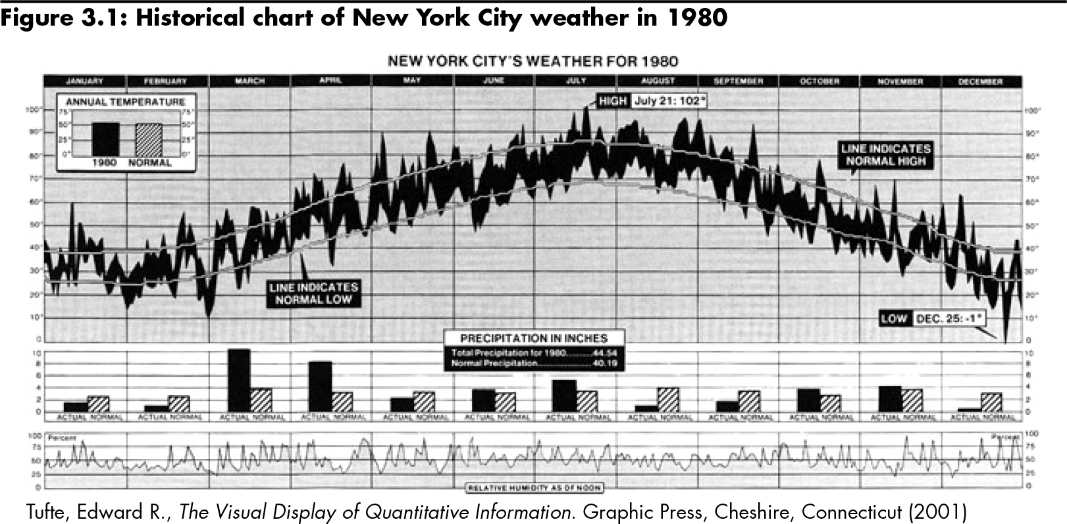
Visualizing Data
Level 1 home

Slide 7
Visualizing Data (continued)
Data graphics principles (Tufte)
Above all else, show the data
Maximize the data-ink ratio, within reason
Erase non-data-ink, within reason
Erase redundant data-ink, within reason
Revise and edit
Level 1 home

Slide 8
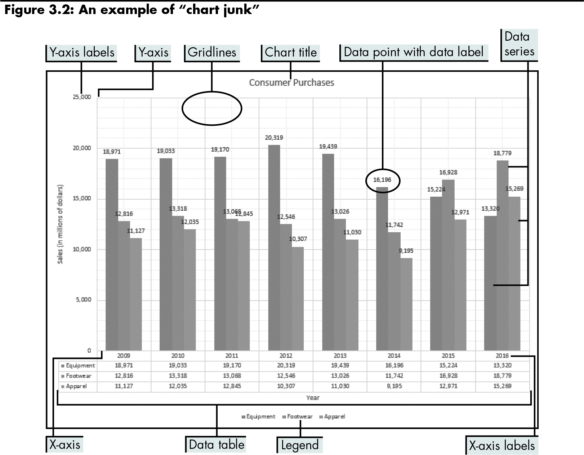
Visualizing Data (continued)
Level 1 home

Slide 9
Effective Data Display
“Above all else show the data”
Reminder not to clutter a chart by adding unnecessary illustration or decoration
“Maximize the data-ink ratio”
Refers to the portion of ink that is devoted to displaying the data versus the portion of the graphic that can be removed without losing the data
Level 1 home

Slide 10
Effective Data Display (continued)
“Erase non-data-ink”
Non-data-ink is a part of the chart that decorates more than informs
“Erase redundant data ink”
Redundant data ink is ink that repeats information
“Revise and edit”
Revise and edit charts like you would a piece of writing
Level 1 home

Slide 11
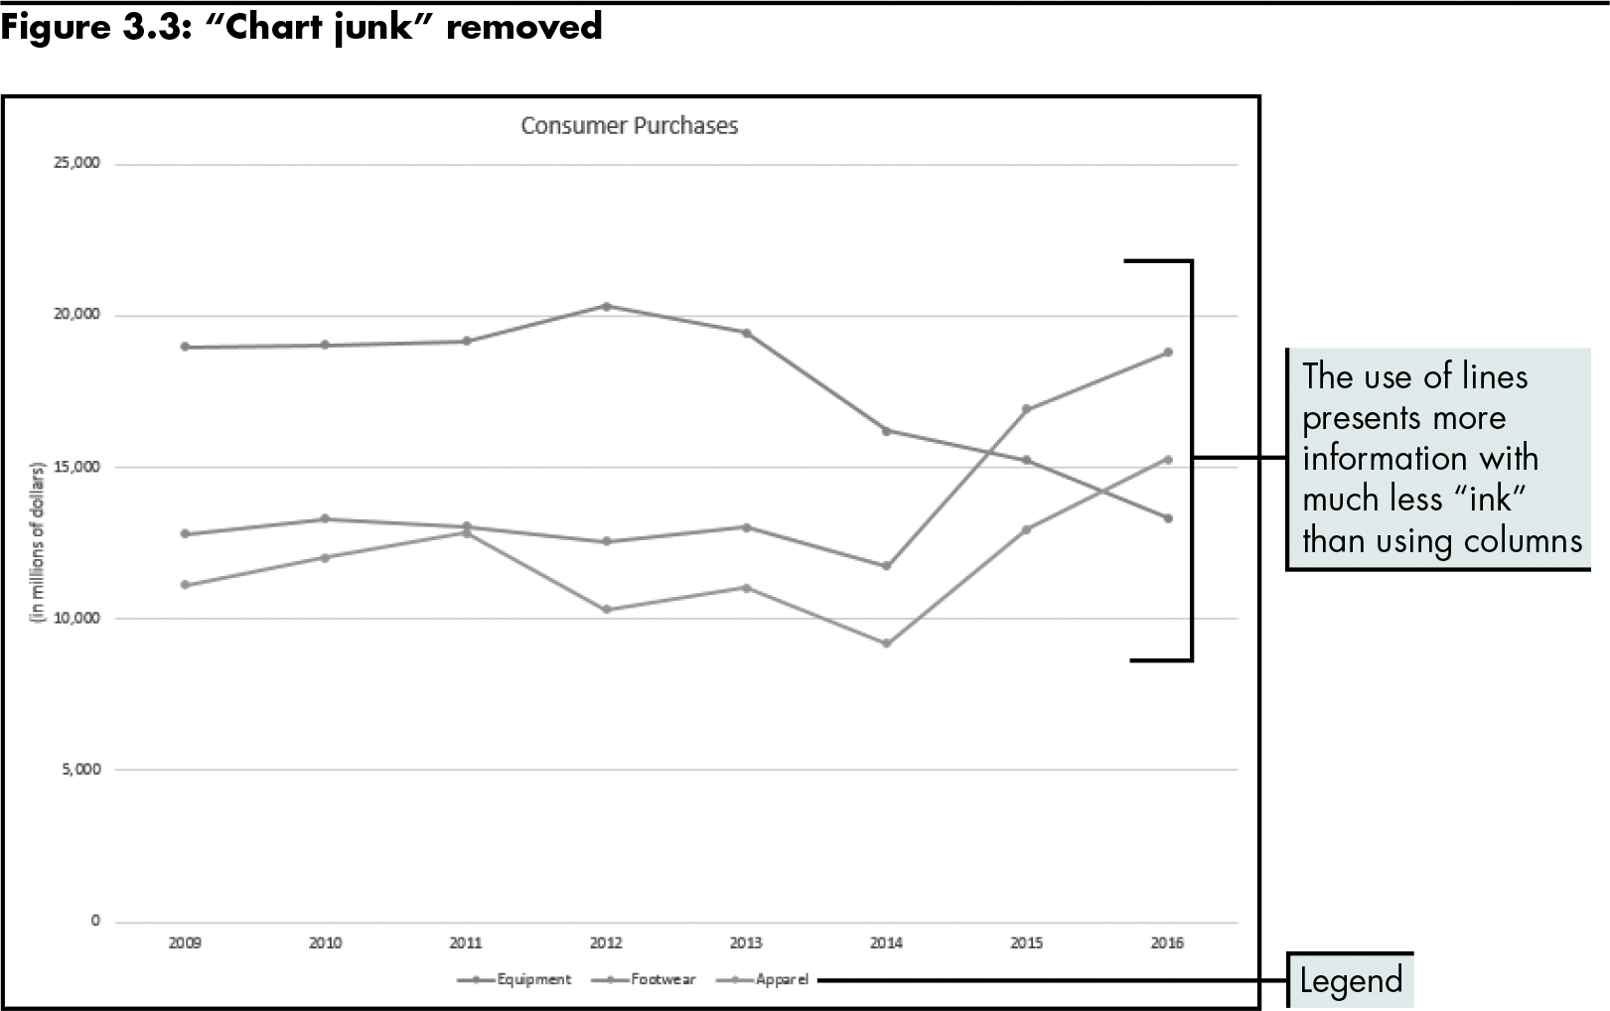
Effective Data Display (continued)
Level 1 home

Slide 12
Effective Data Display (continued)
Sparklines
Small word-sized charts or graphics that are embedded within the words, numbers, and images they represent
Make multiple comparisons of trends and patterns much easier
Level 1 home

Slide 13
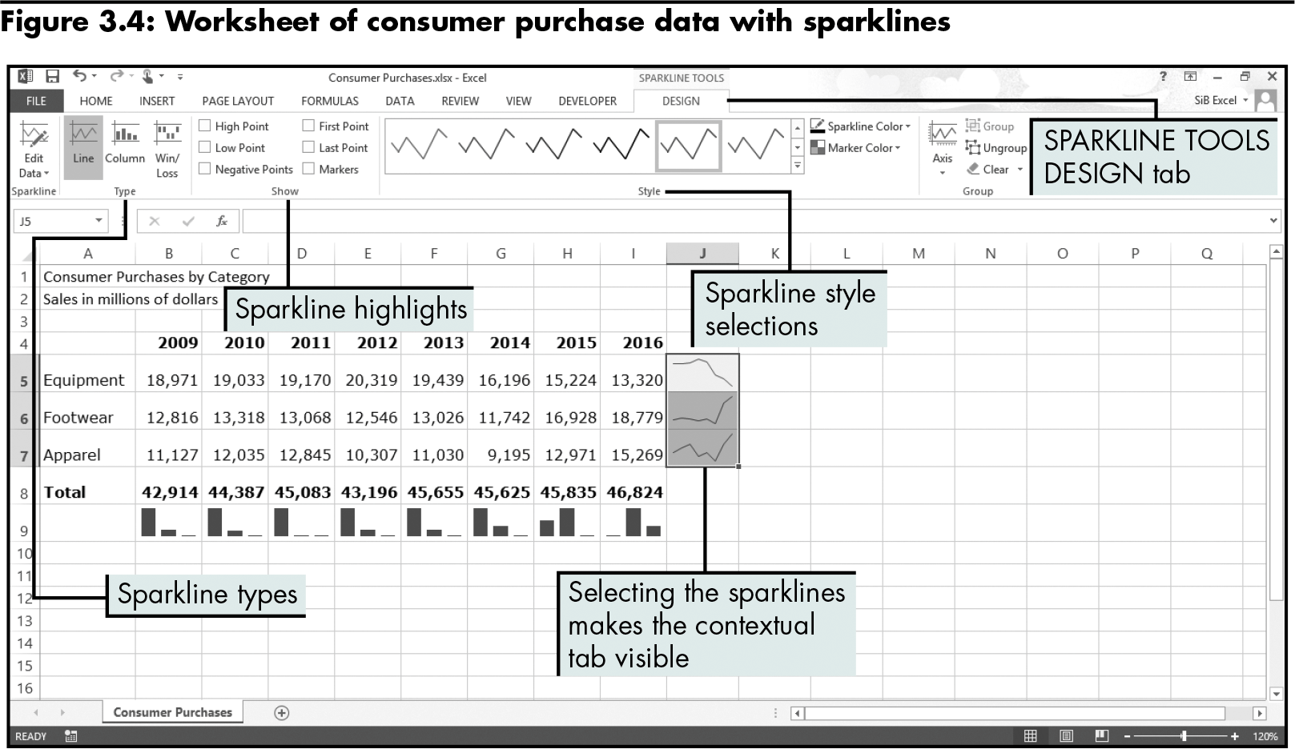
Effective Data Display (continued)
Level 1 home

Slide 14
Effective Charting in Excel
Creating a chart in Excel:
Select the data to display
Click the INSERT tab
Click a button in the Charts group or the Dialog Box Launcher
Level 1 home

Slide 15
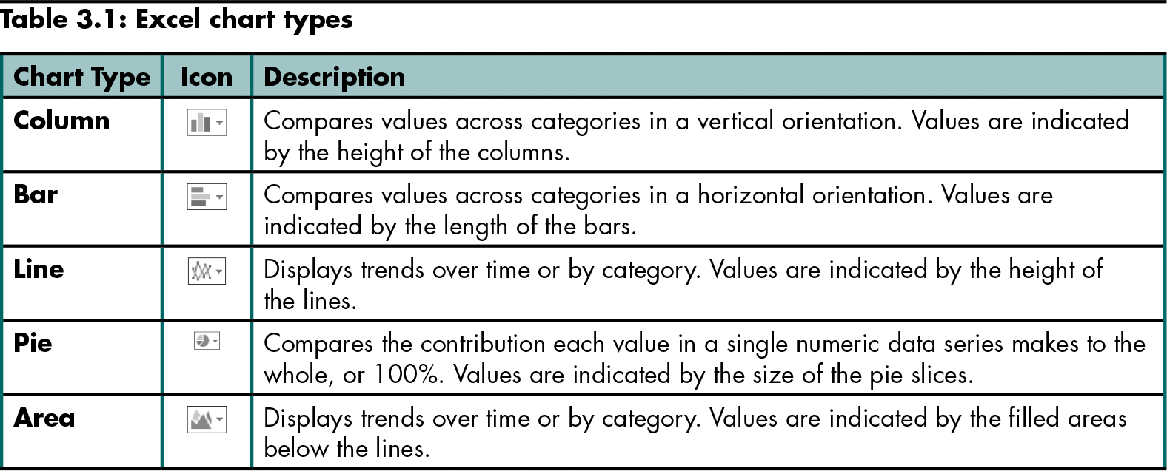
Effective Charting in Excel (continued)
Level 1 home

Slide 16
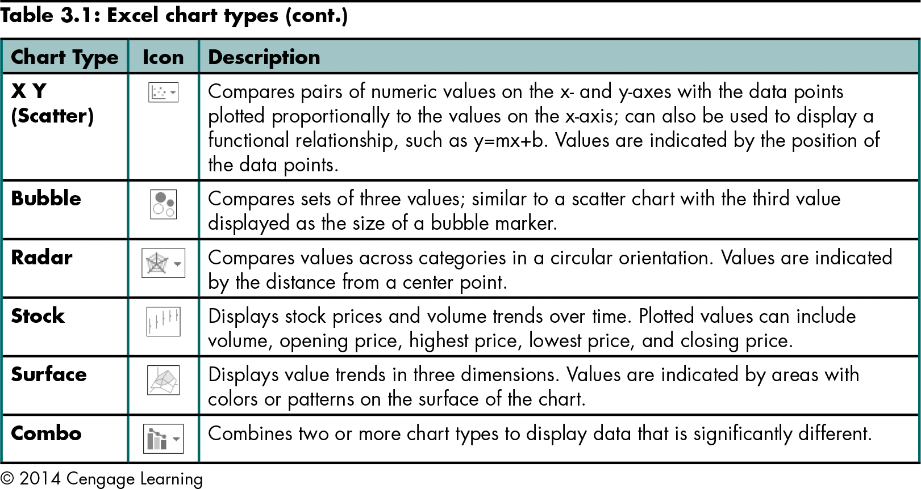
Effective Charting in Excel (continued)
Level 1 home

Slide 17
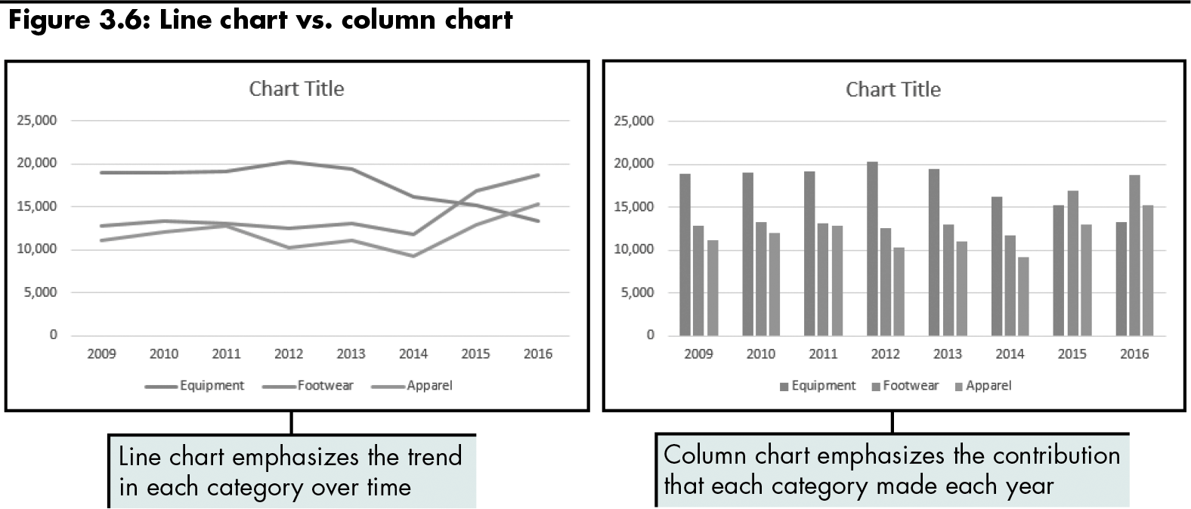
Effective Charting in Excel (continued)
Line chart: displays trends over time or by category
Column chart: compares values across categories in a vertical orientation
Level 1 home

Slide 18
Effective Charting in Excel (continued)
Comparing line and X Y (Scatter) charts:
X Y (Scatter) charts plot numeric values on both the x- and y-axes based on the value of the data
Line charts plot numeric values on one axis and category labels equidistantly on the other axis
Level 1 home

Slide 19
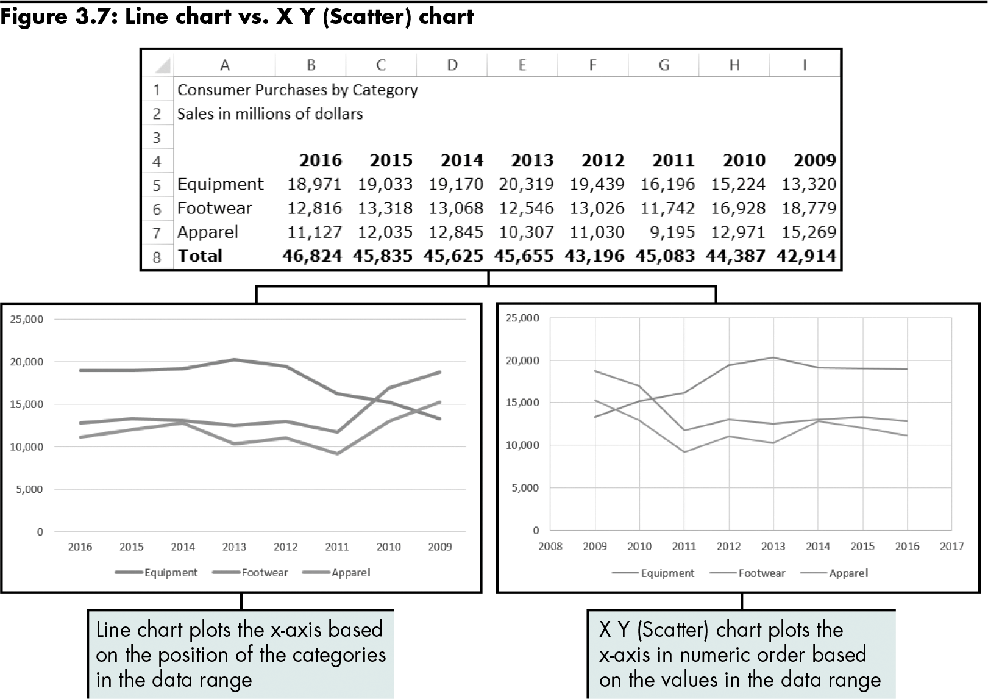
Effective Charting in Excel (continued)
Level 1 home

Slide 20
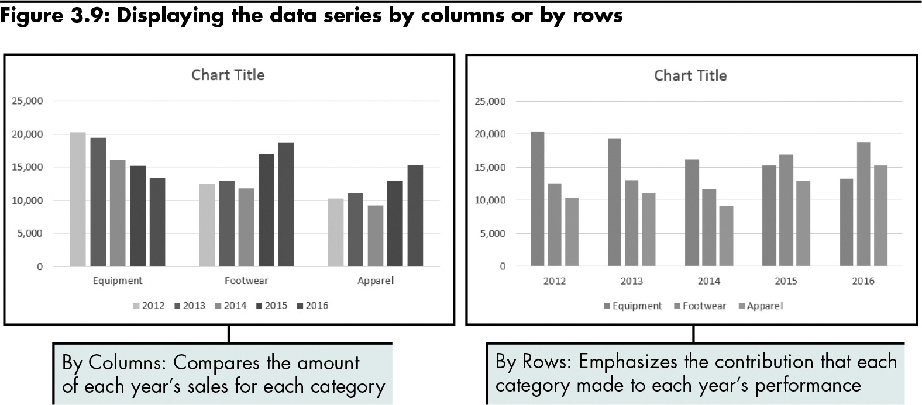
Effective Charting in Excel (continued)
Level 1 home

Slide 21
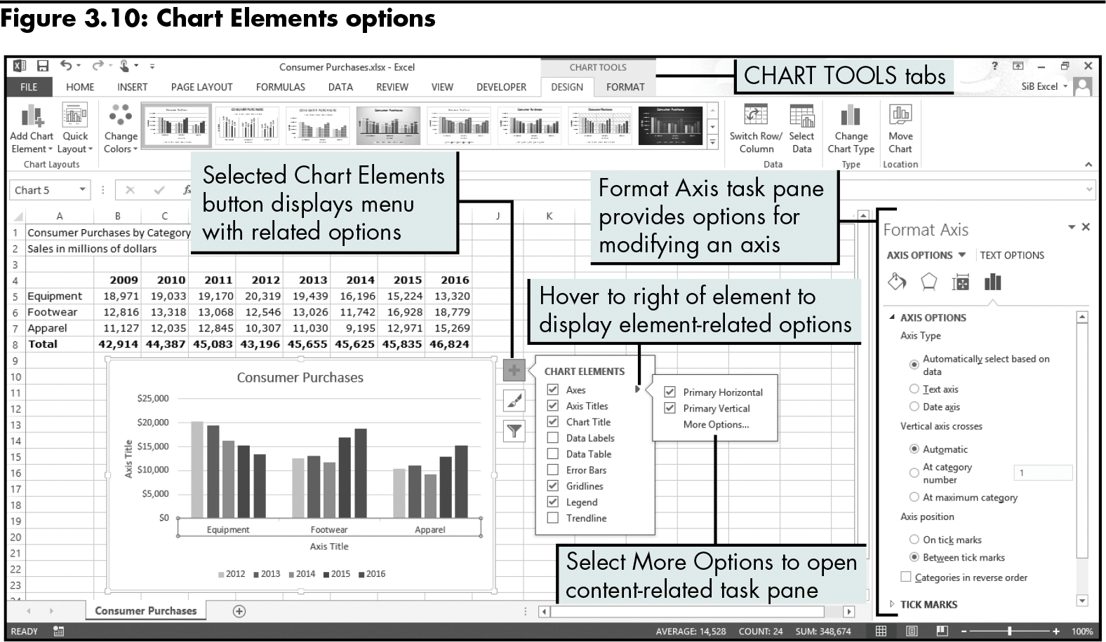
Effective Charting in Excel (continued)
Specifying chart layout options:
Click the Chart Elements button
Level 1 home

Slide 22
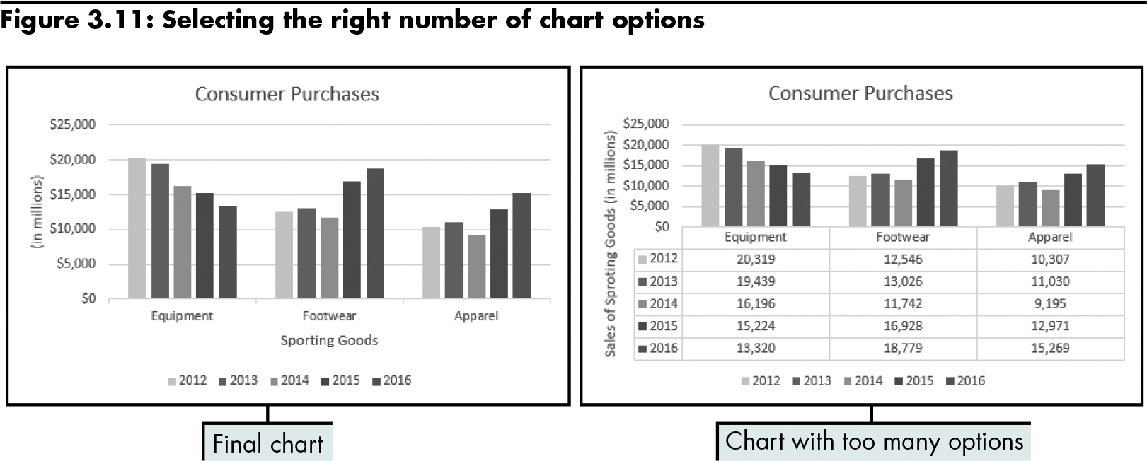
Effective Charting in Excel (continued)
Level 1 home

Slide 23
Effective Charting in Excel (continued)
Understanding area and pie charts:
Area chart: combines the features of a line chart with a bar or column chart by filling in the area below the line, and displaying the trend values over time or categories
Pie chart: displays the percentage contribution that each category makes to a whole or 100%
Level 1 home

Slide 24
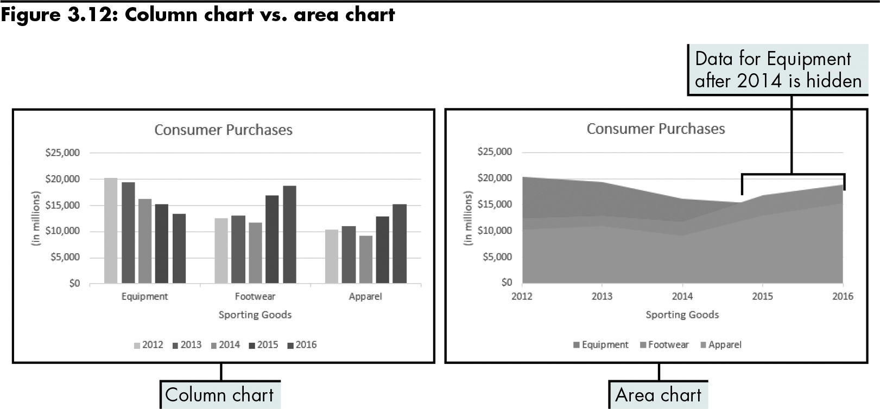
Effective Charting in Excel (continued)
Level 1 home

Slide 25
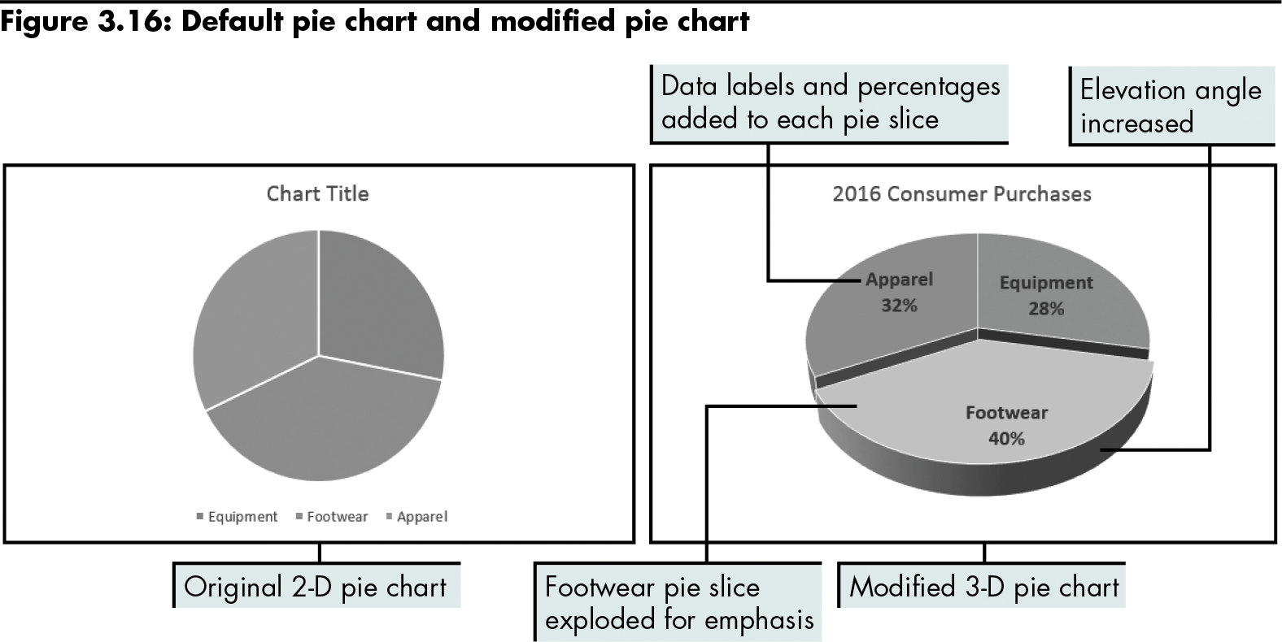
Effective Charting in Excel (continued)
Level 1 home

Slide 26
Level 1 Summary
Using charts to illustrate quantitative information adds visual analysis to problem solving
Tufte’s guiding principles on the creation of graphics
How the choice of chart type can influence the viewer’s perception of information presented
Differences between main chart types
Different interpretation of data can result from using a different chart type

Slide 27
Level 2 Objectives: Evaluating Chart Sub-Types
Examine the effectiveness of different chart sub-types
Evaluate the stacked and 100% stacked sub-types
Explore the Pie of Pie and Bar of Pie sub-types
Create various stock charts to display financial data
Clarify data with trendlines and moving averages

Slide 28
Examining Sub-Types for Various Chart Types
Stacked charts | Illustrate cumulative effects of data in categories Available for line, bar, column, and area charts
Summing to 100% (100% stacked sub-type) | Illustrate cumulative (rather than individual) contribution for each category as a percentage Available for line, bar, column, and area charts Combine features of a pie chart with features of line, column, or area charts Similar to a pie chart except pieces are in a column instead of a circle
Level 2 home

Slide 29
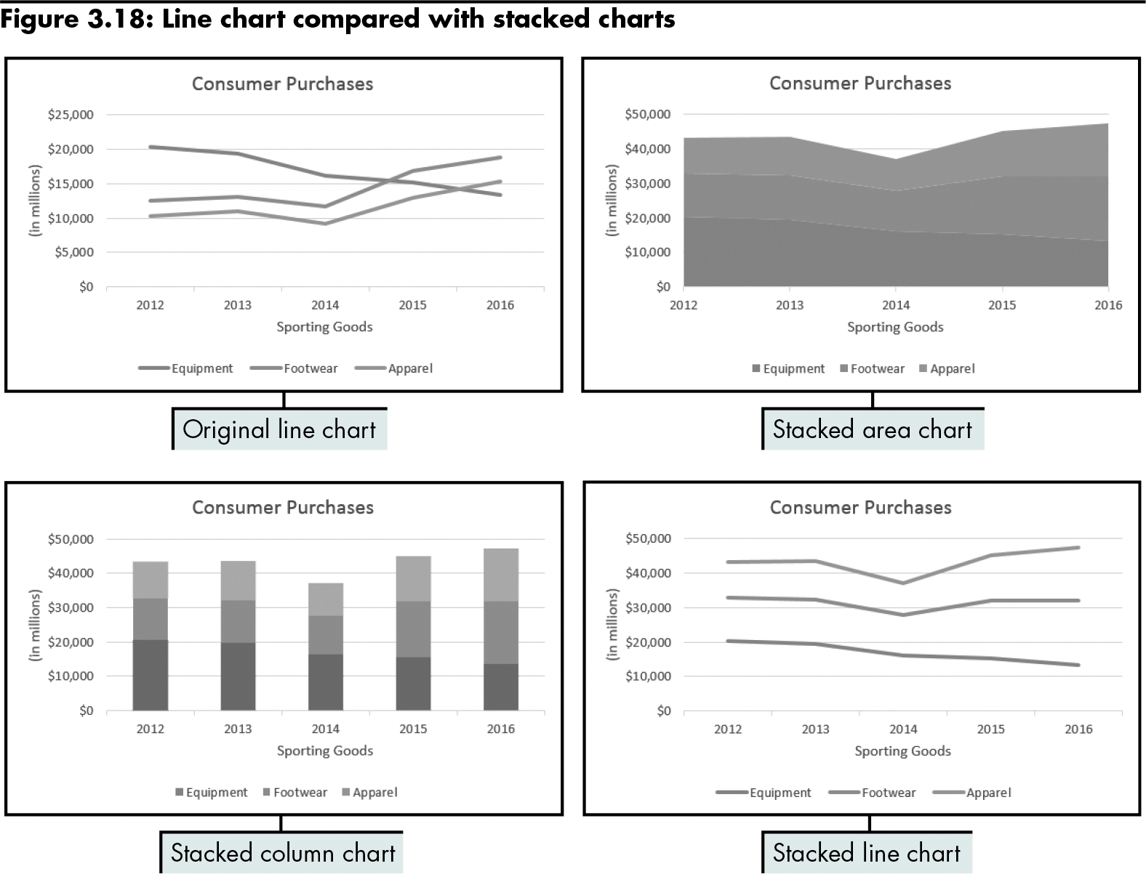
Examining Sub-Types for Various Chart Types (continued)
Level 2 home

Slide 30
Examining Sub-Types for Various Chart Types (continued)
Summing to 100%: alternatives to pie charts
Showing the cumulative contribution for each category as a percentage can reduce confusion over whether the line on the chart represents the individual or cumulative contribution to the whole
Level 2 home

Slide 31
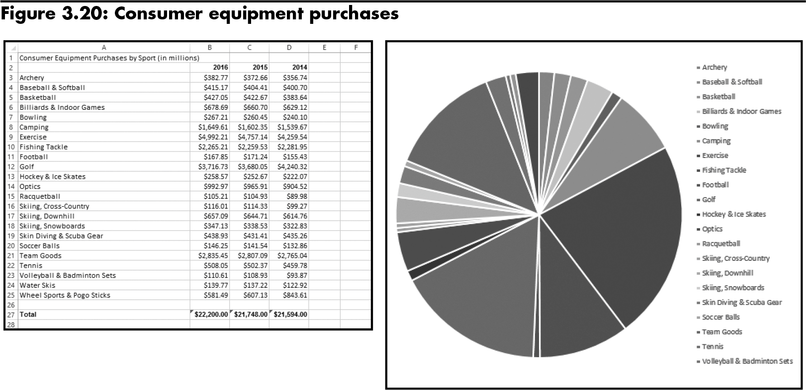
Examining Sub-Types for Various Chart Types (continued)
An excessive number of pie slices makes the chart cluttered and confusing.
Level 2 home

Slide 32
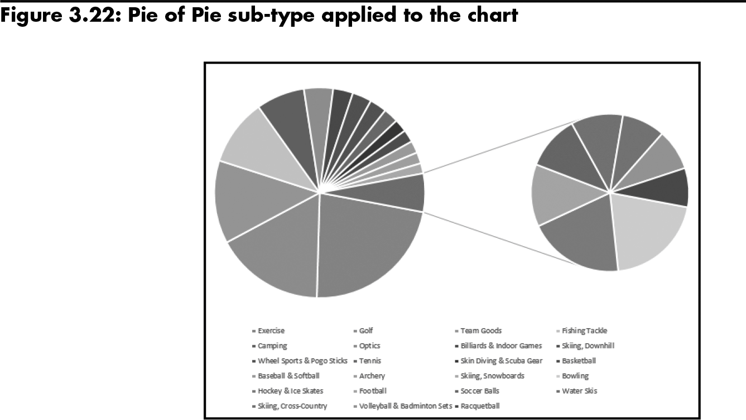
Examining Sub-Types for Various Chart Types (continued)
Pie of Pie and Bar of Pie chart sub-types
Decrease the number of pie segments to improve the visual display of data
Use the Format Data Series task pane to select options for splitting: data series
Position
Value
Percent Value
Custom
Level 2 home

Slide 33
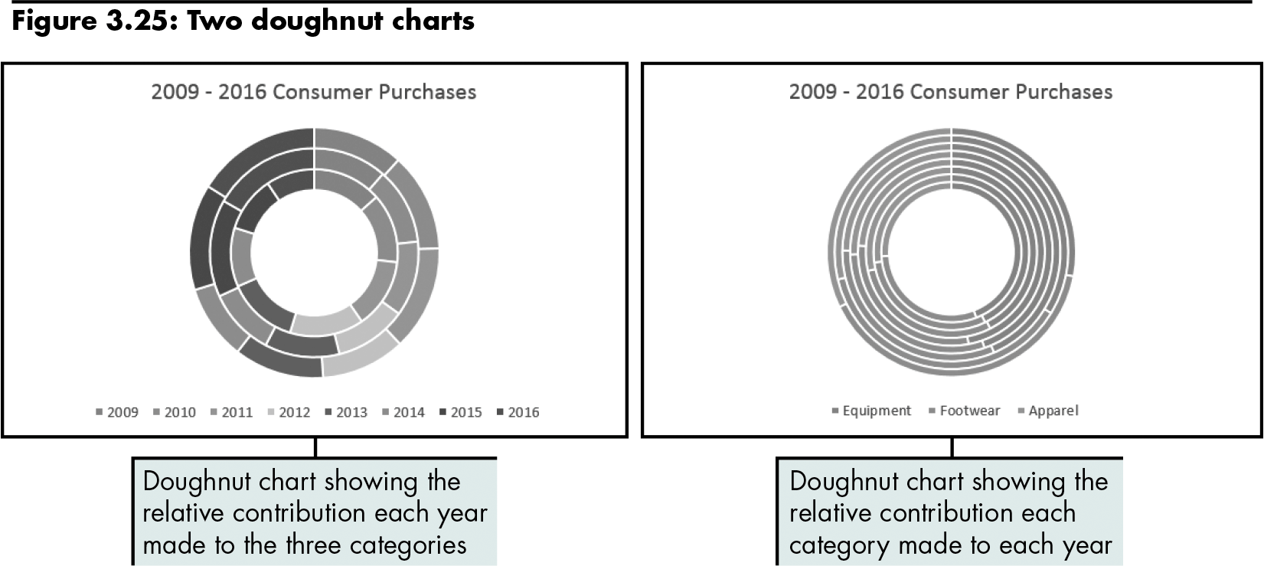
Examining Sub-Types for Various Chart Types (continued)
Doughnut charts
Show individual percentages contained in a pie chart for more than one series
Level 2 home

Slide 34
Examining Sub-Types for Various Chart Types (continued)
Monitoring a business with stock charts
Excel stock reporting charts are somewhat based on the candlestick plot format
Stock chart sub-types:
High-Low-Close
Open-High-Low-Close
Volume-High-Low-Close
Volume-Open-High-Low-Close
Level 2 home

Slide 35
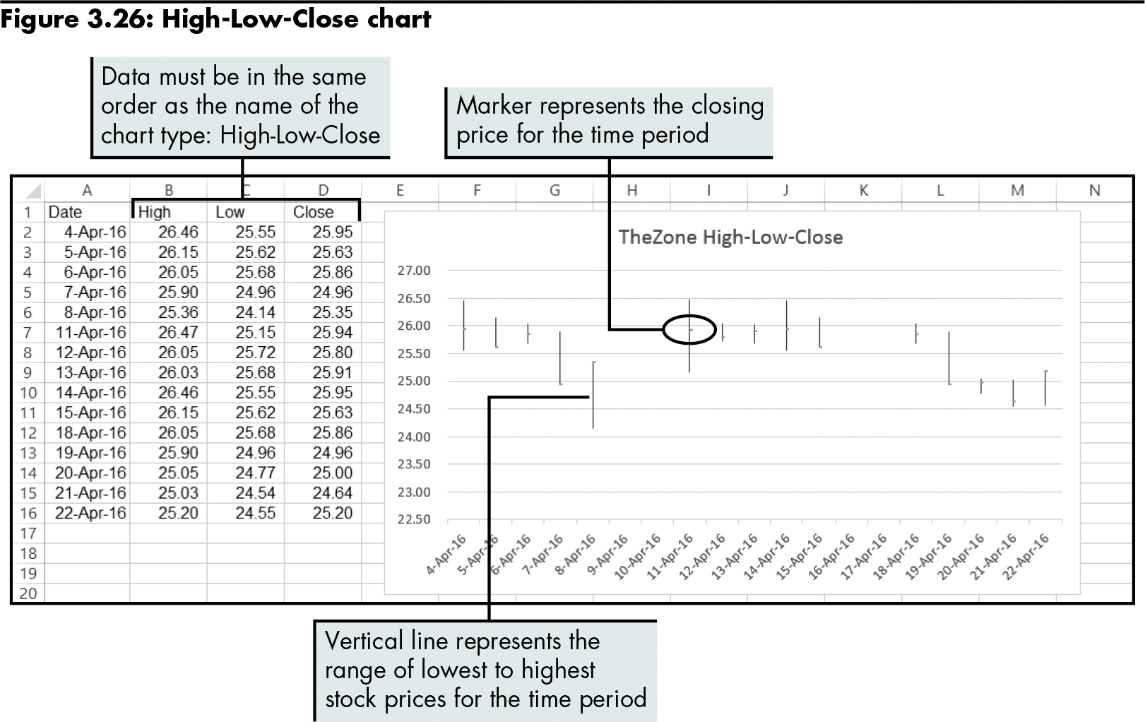
Examining Sub-Types for Various Chart Types (continued)
Level 2 home

Slide 36
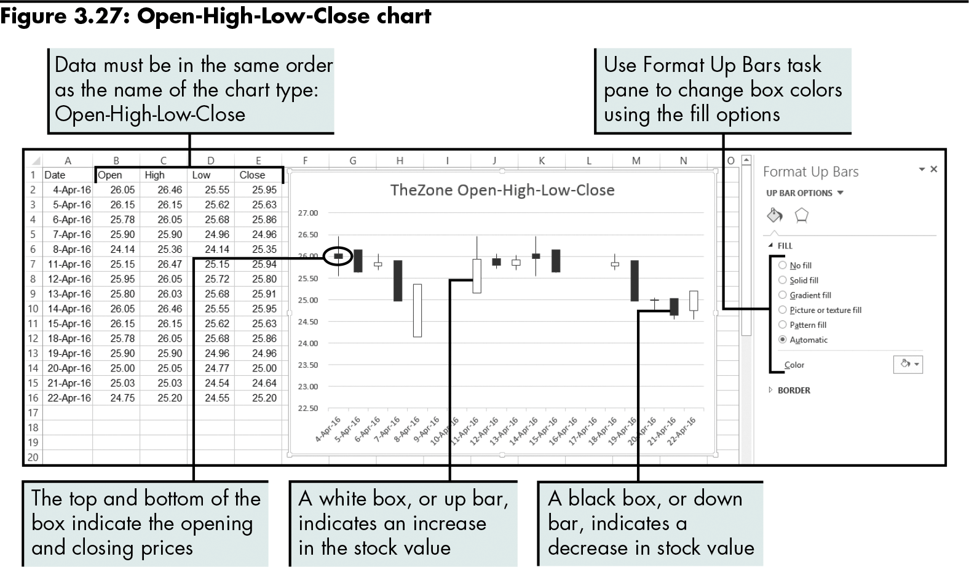
Examining Sub-Types for Various Chart Types (continued)
Level 2 home

Slide 37
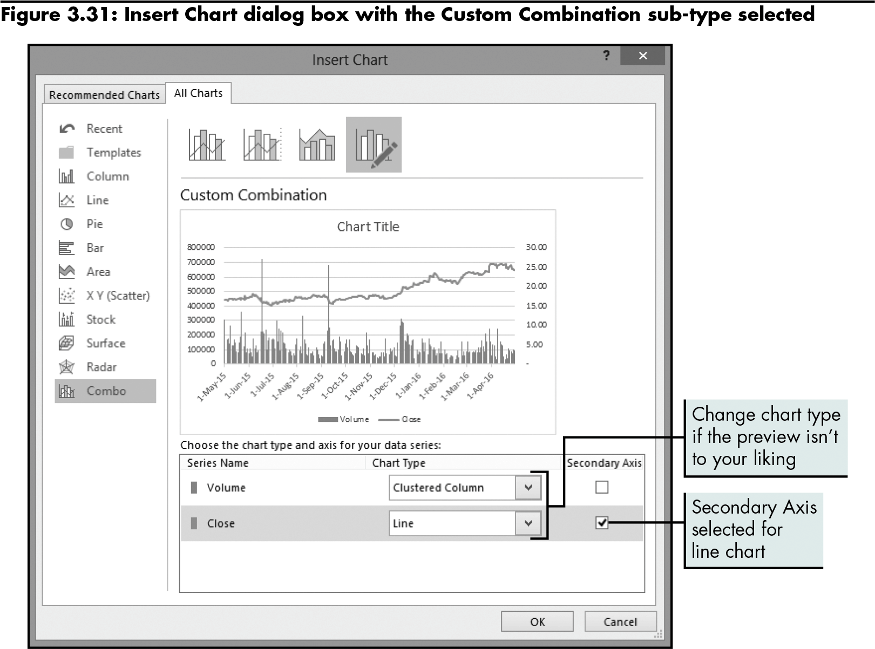
Examining Sub-Types for Various Chart Types (continued)
Using a combo chart
Level 2 home

Slide 38
Examining Sub-Types for Various Chart Types (continued)
Trendlines
Graphically illustrate trends in data using a statistical technique known as regression
Moving average trend line
Used to smooth out the data, making it easier to spot trends
Level 2 home

Slide 39
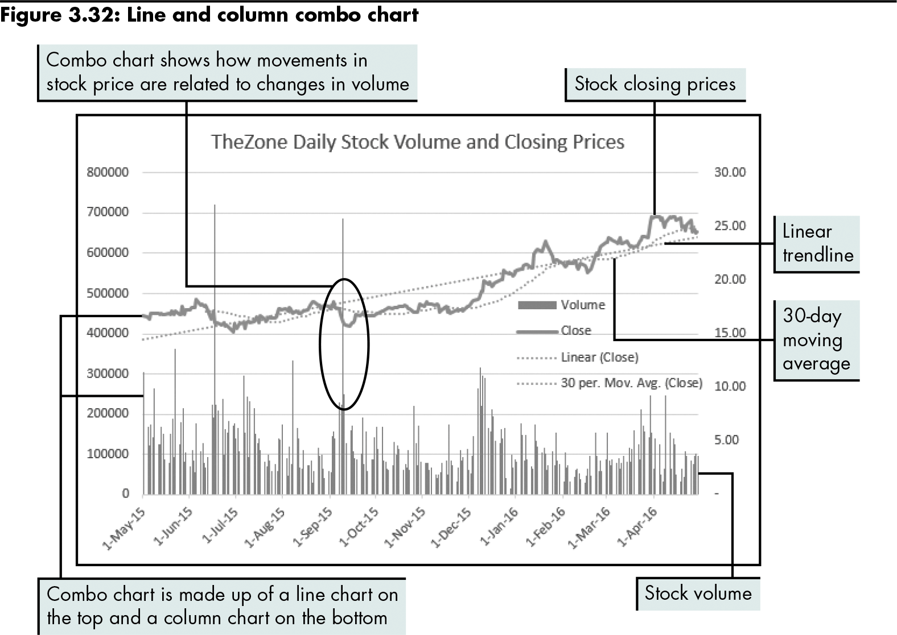
Examining Sub-Types for Various Chart Types (continued)
Adding trendlines and moving averages
Level 2 home

Slide 40
Level 2 Summary
Chart sub-types for line, column, and area charts (stacked and 100% stacked)
Pie of Pie and Bar of Pie chart sub-types
Sub-types of stock charts
Clarifying data in stock charts using trendlines and moving averages

Slide 41
Level 3 Objectives: Exploring More Advanced Chart Types
Understand and evaluate radar, bubble, and dashboard charts
Compare a bubble chart with a 3-D column chart
Explore and customize a dashboard chart
Create and customize a doughnut chart

Slide 42
Evaluating the Effectiveness of Radar, Bubble, and Dashboard Charts
Radar charts | Powerful method of displaying and comparing data across categories
Bubble charts | Allow three-dimensional data to be plotted in 2-D on two axes
Dashboard charts | Feature a set of charts that summarize several sets of data graphically
Level 3 home

Slide 43
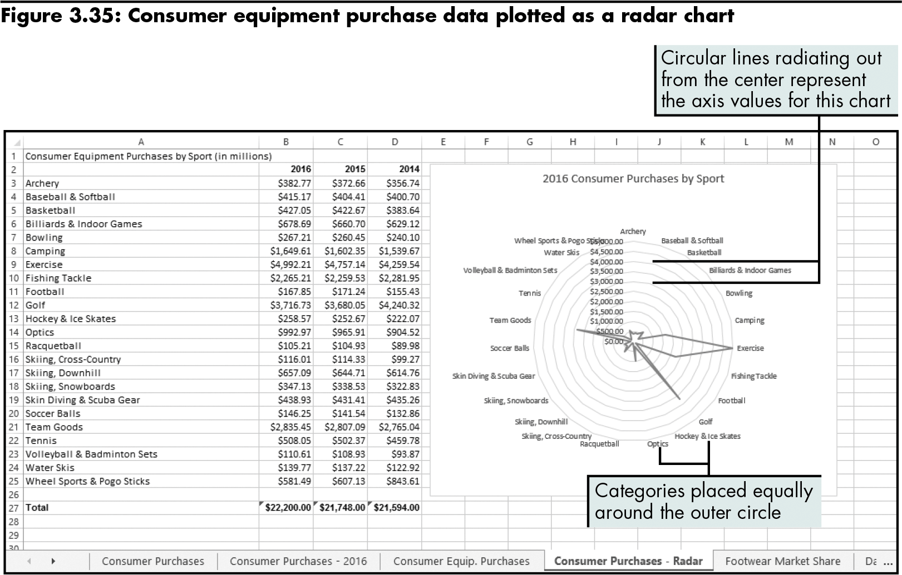
Evaluating the Effectiveness of Radar, Bubble, and Dashboard Charts (continued)
Understanding radar charts
The straight lines that radiate out from the center represent categories.
Level 3 home

Slide 44
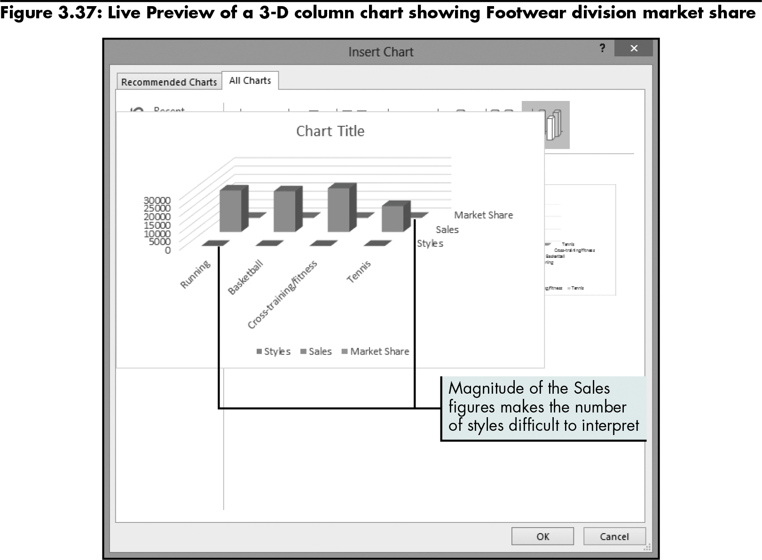
Evaluating the Effectiveness of Radar, Bubble, and Dashboard Charts (continued)
Plotting 3-D data in two axes: bubble charts versus 3-D column charts
Level 3 home

Slide 45
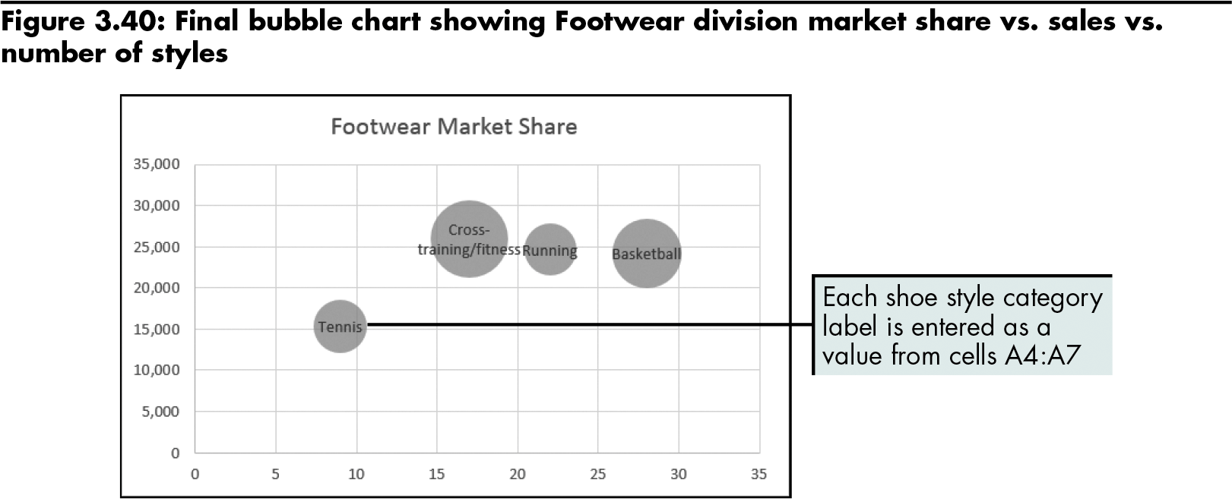
Evaluating the Effectiveness of Radar, Bubble, and Dashboard Charts (continued)
Sample bubble chart
The market share of each shoe style is represented by the size of the bubbles.
Level 3 home

Slide 46
Evaluating the Effectiveness of Radar, Bubble, and Dashboard Charts (continued)
Creating a management dashboard:
Build a dashboard chart
Define the normal operating range
Create the value indicator
Create the doughnut chart
Add digital values to the chart
Level 3 home

Slide 47
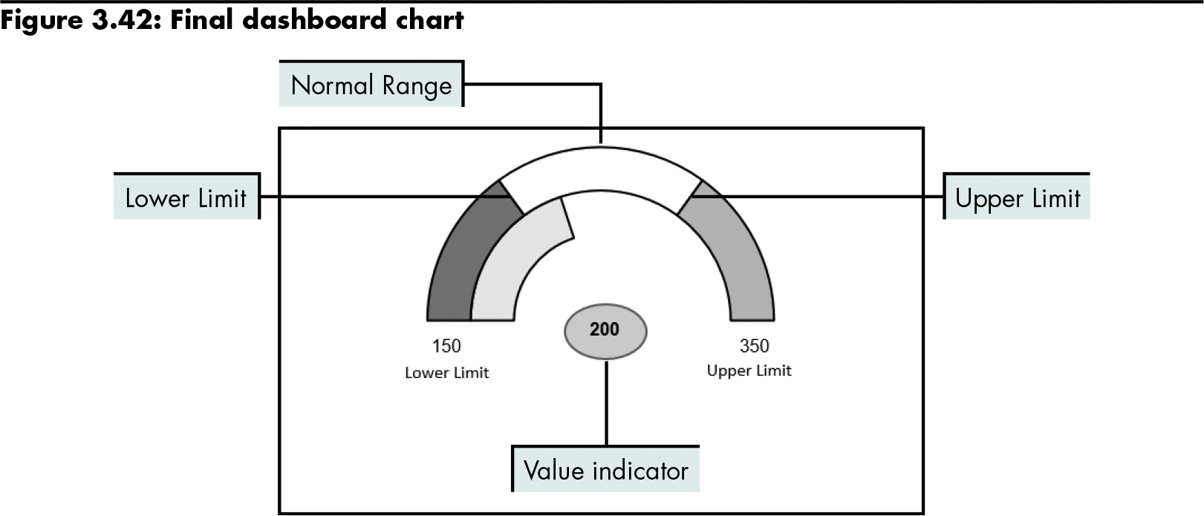
Evaluating the Effectiveness of Radar, Bubble, and Dashboard Charts (continued)
Build a dashboard chart
Level 3 home

Slide 48
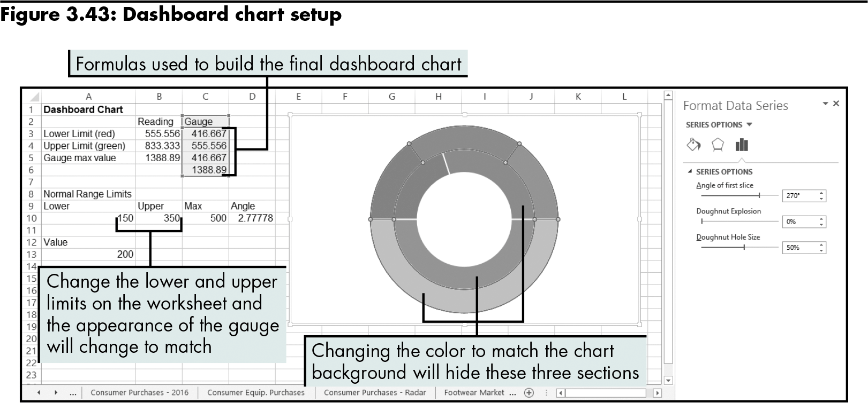
Evaluating the Effectiveness of Radar, Bubble, and Dashboard Charts (continued)
Define the normal operating range
Level 3 home

Slide 49
Level 3 Summary
More advanced chart types
Radar charts
Bubble charts
How to combine chart types within the same chart to build a management dashboard

Slide 50
Chapter Summary
Charts offer the opportunity to add visual analysis to problem solving
Chart types:
Line
Column
Bar
Area
Pie
X Y (Scatter)

Slide 51
Chapter Summary (continued)
Chart sub-types further summarize the data being presented
Advanced chart types such as radar and bubble charts

Slide 52
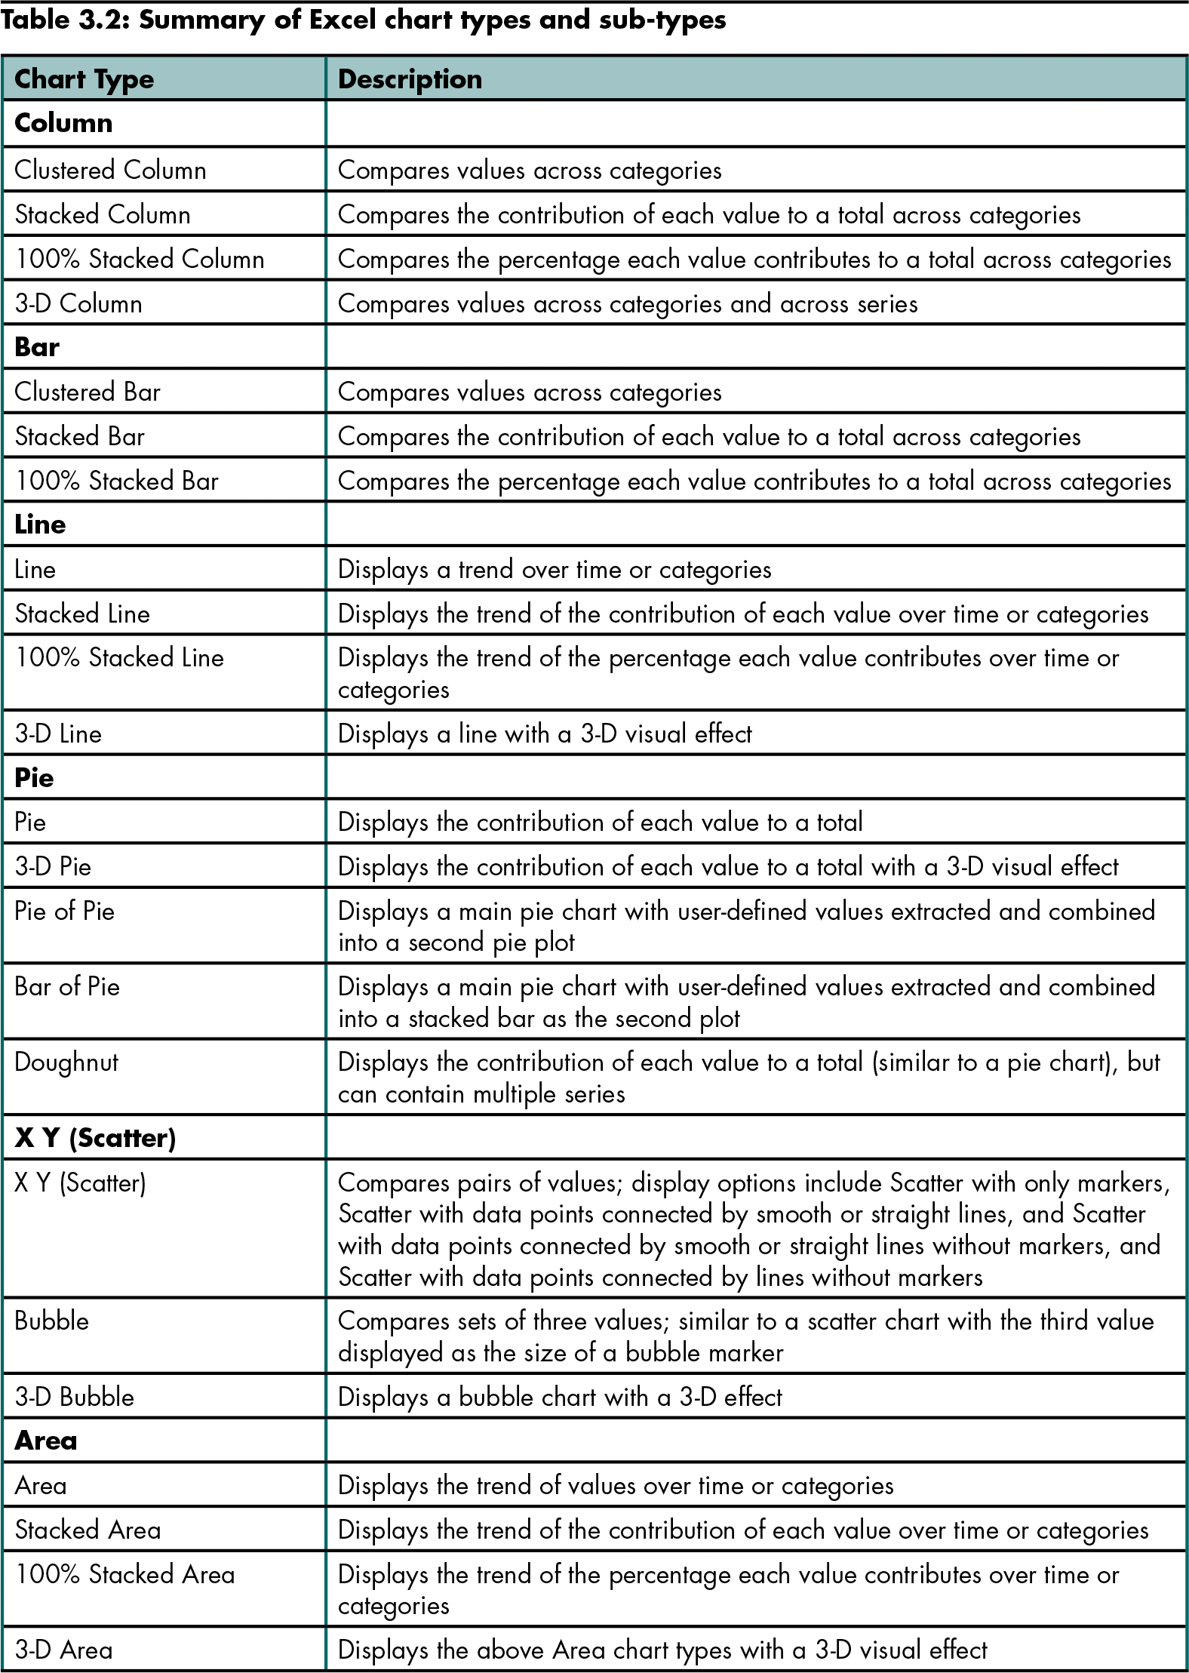
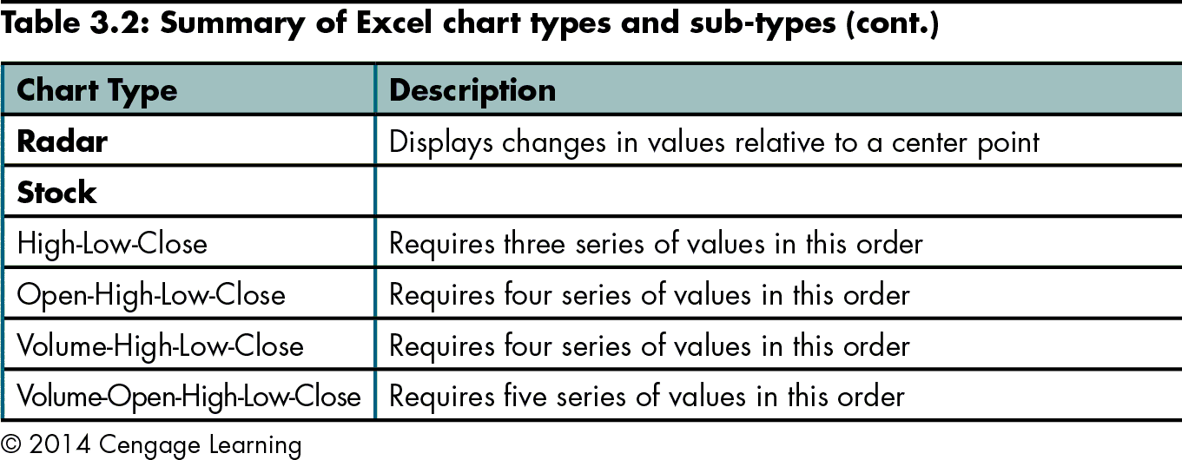
Chapter Summary (continued)

